Slide 1
Learn to code with Swift 3

Slide 2


Variables/cConstants

Slide 3

Optionals
You use optionals in situations where a value may be absent. An optional represents two possibilities: Either there is a value, and you can unwrap the optional to access that value, or there isn’t a value at all.

Slide 4
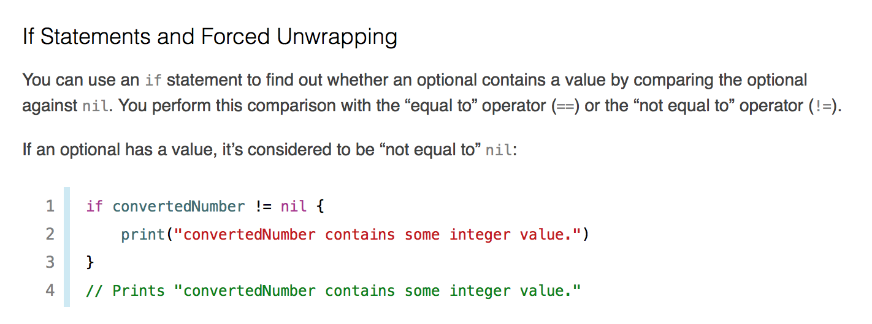
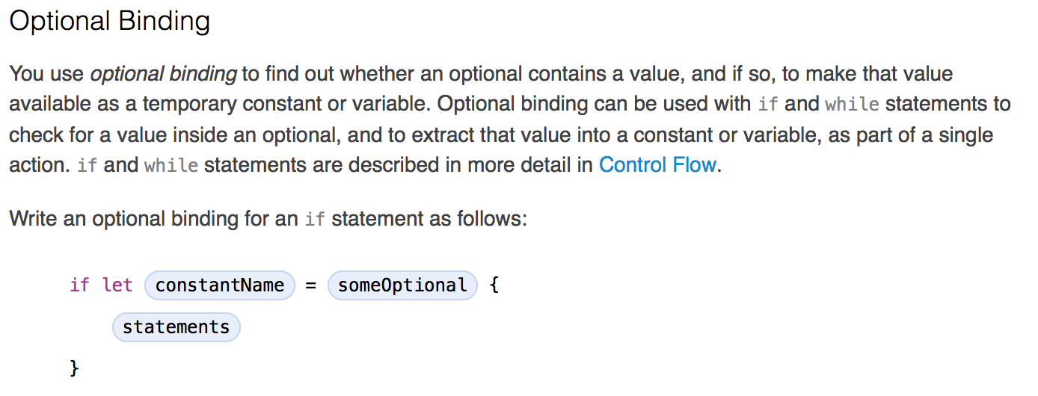

Slide 6
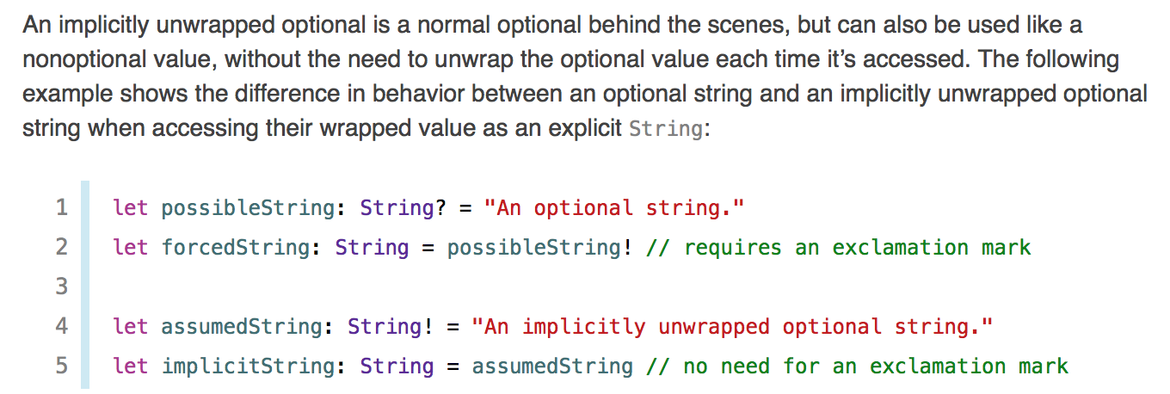
Implicitly Unwrapped Optionals

